Slide 1

Catalyst For CP
​

Slide 2
What is STL?
~treasure of C++

Slide 3
Why STL?

Slide 4
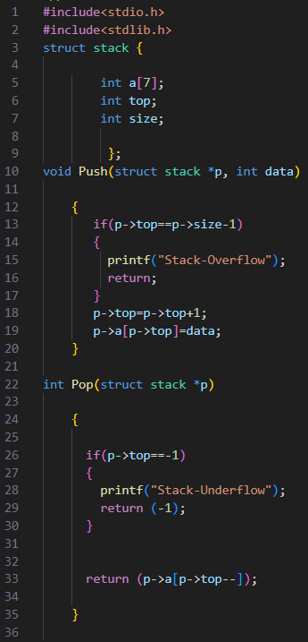
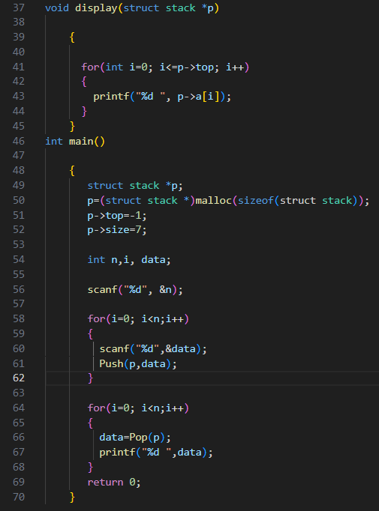
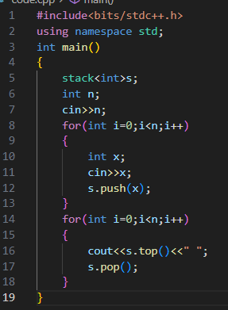

Slide 5
Basic stl algorithms
sort
max_element
min_element
count
find
binarysearch
unique
erase
accumulate
reverse

Slide 6
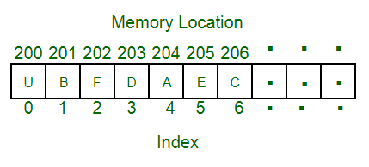
What is vector?

Slide 7
Basic Vector functions
begin()
end()
front()/back()
clear()
empty()
assign()
push_back()
pop_back()
insert
erase

Slide 8


REGISTER NOW:
JOIN THE WHATSAPP GROUP NOW:

Slide 9
If you have an iterator that points to a particular member of Container, you can access the element in O(1) time , among other things. You can find the next and previous members of the set (if they exist), regardless of the key type, and without a prior knowledge of their existence. You can't do that with an index.
“
”

Slide 10
THANK YOU

